Slide 1
Unit 3 - Lesson 2
Introduction to Design Mode

Slide 3
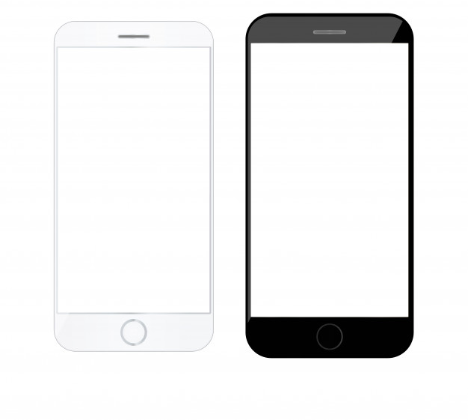
Unit 2 Lesson 2 - Warm Up
Prompt:
What is a common app that you use? Take a minute to sketch the User Interface of the main screen. Note how the user interacts with the app.

Slide 5
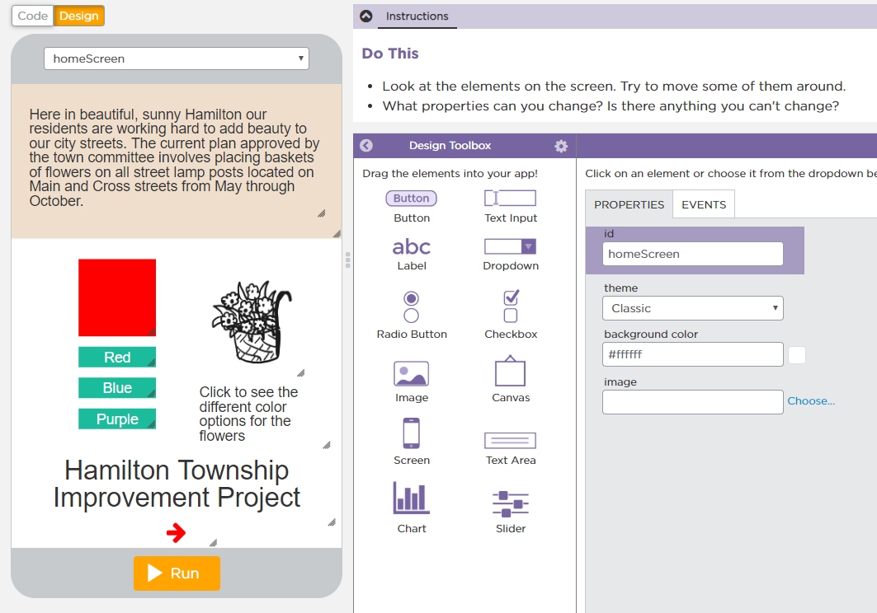
Unit 2 Lesson 2 - Activity
Introduction to Design Mode

Slide 7
Unit 3 Lesson 2 - Wrap Up
Prompt:
What elements collect input?
What elements display output?
Do you think there are elements that can do both?

Slide 8
Unit 3 - Lesson 3
Project - Designing an App Part 1

Slide 10
Unit 3 Lesson 3 - Warm Up
Prompt: People design user interfaces to meet a user's needs, but they don't always get it right.
Have you ever used an app where the user interface didn't actually meet your needs?
What was the problem?
What do you think the designers didn't understand about you or your needs?

Slide 12
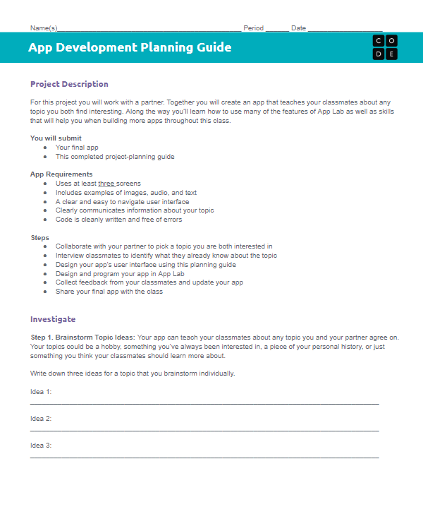
Unit 3 Lesson 3 - Activity
Designing an App Part 1
You should have:
App Development Planning Guide

Slide 13
Unit 3 Lesson 3 - Activity
Step 1:
Brainstorm Topic Ideas

Slide 14
Unit 3 Lesson 3 - Activity
Do This:
Choose a partner!

Slide 15
Unit 3 Lesson 3 - Activity
Tip:
Keep an eye out for bias! Collaboration with others is key.

Slide 16
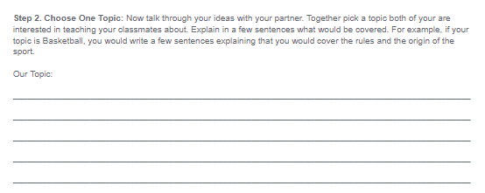
Unit 3 Lesson 3 - Activity
Step 2:
Choose One Topic

Slide 17
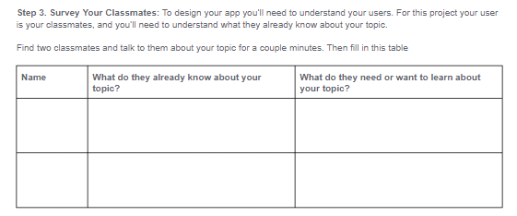
Unit 3 Lesson 3 - Activity
Step 3:
Survey Your Classmates

Slide 18
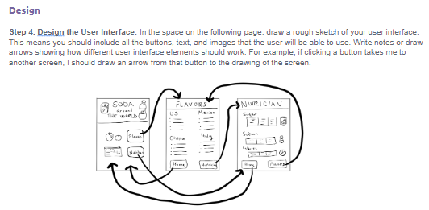
Unit 3 Lesson 3 - Activity
Step 4:
Design the User Interface

Slide 20
Unit 3 Lesson 3 - Wrap Up
Prompt:
How did talking with the users of your app impact your design decisions?

Slide 21
Unit 3 - Lesson 4
Project - Designing an App Part 2

Slide 23
Unit 3 Lesson 4 - Warm Up
Prompt:
Why is it important to plan out the design of an app?

Slide 25
Unit 3 Lesson 4 - Activity
Designing an App Part 2
You and your partner should have:
App Development Planning Guide
Pen/Pencil

Slide 26
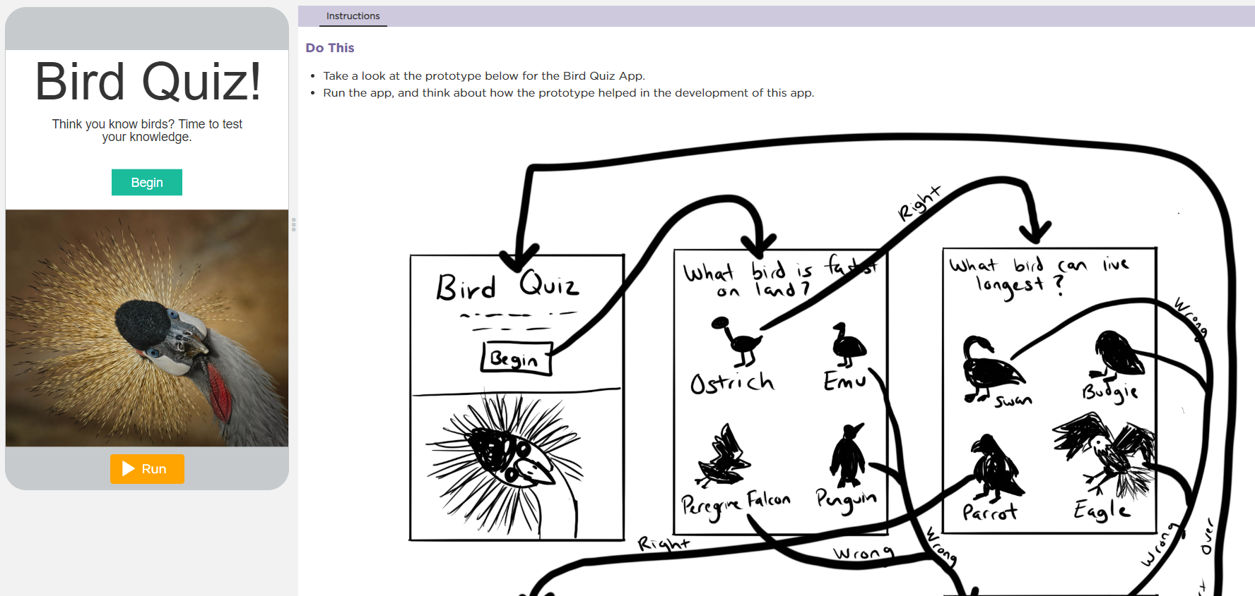
Unit 3 Lesson 4 - Activity
Step 5: Create Your User Interface
Do This: Navigate to Code Studio, Lesson 4, Level 1. Follow the instructions.

Slide 27
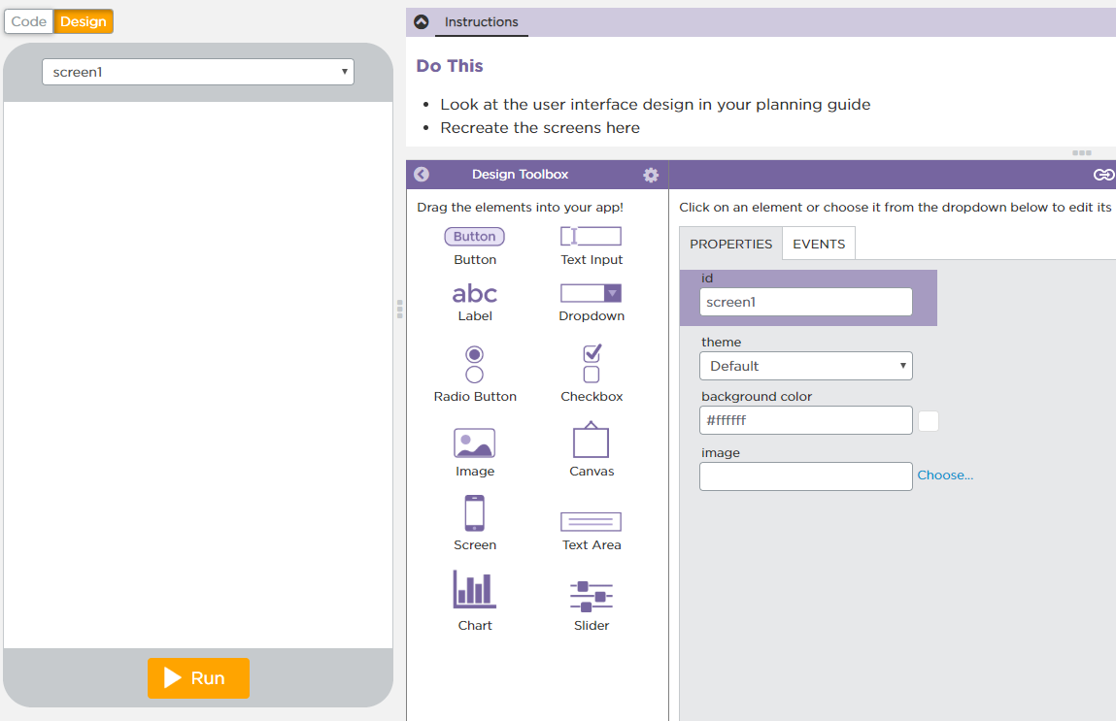
Unit 3 Lesson 4 - Activity
Do This: Navigate to Level 2.
Start building your user interfaces!

Slide 28
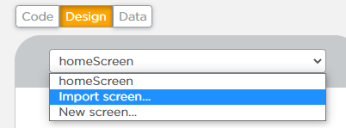
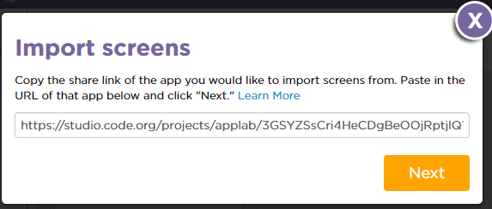
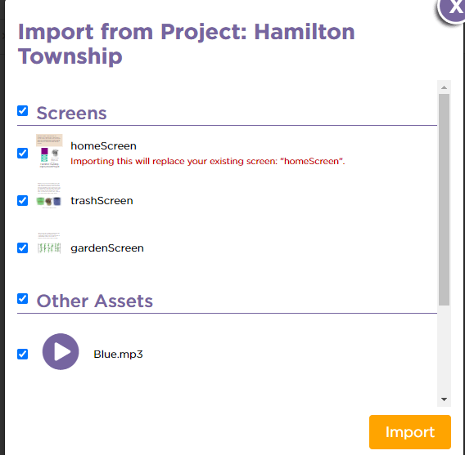
Unit 3 Lesson 4 - Activity
If you divided the screens with a partner, here's how to combine them into one project.
Partner A
Partner B
Choose one partner to host the project (Partner A).
Partner A clicks the screen dropdown, then clicks "Import screen"
Paste in the share link from Partner B.
Partner A select to import all of the screens and assets.
Partner A set the home screen to be the default screen (Hint: Go to design mode and click on the screen)

Slide 30
Unit 3 Lesson 4 - Wrap Up
Prompt:
Were there any changes you had to make to your original design once you transferred it to the screen?

